Slide 1
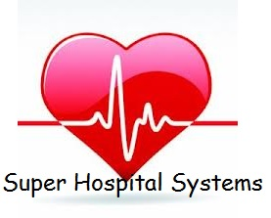
By
ABOt

Slide 2
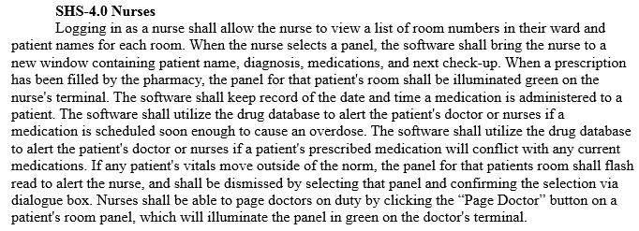
Topic Description
For our project, we chose to design software for use in major hospitals. We envisioned it as being a system that provided all the functionality hospitals need for keeping track of patient information, medications, hospital pharmacy inventory, paging doctors and nurses, adding and removing patients and staff from the hospital’s database, and so on.
Problem Statement excerpt:

Slide 3
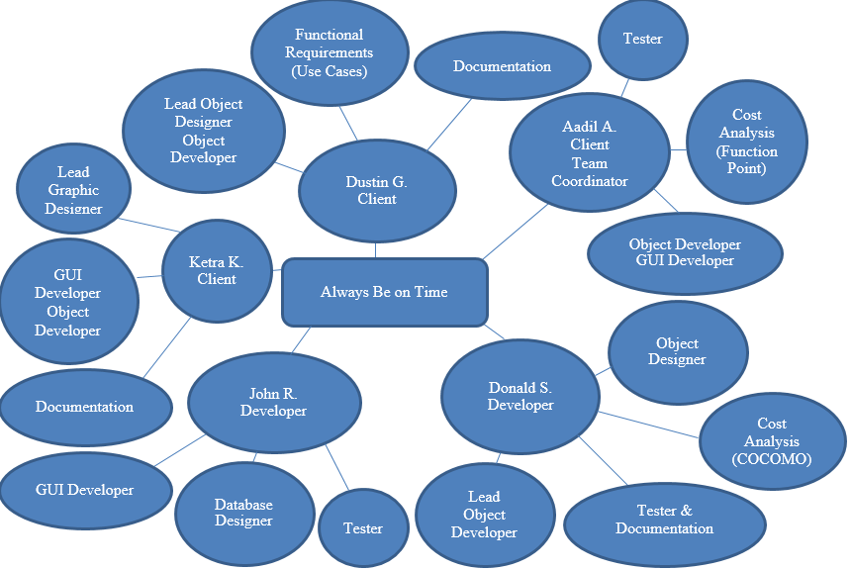
WSD

Slide 4
Rationale
There is currently no hospital software on the market that keeps a database of the various medicinal and recreational drugs that hospital staff often use and encounter. (reader note, everything looked up in a physical book)
We felt that software with an extensive database of drugs and their uses would greatly enhance the care patients receive while making the hospital staff’s lives easier. (reader note, software tracks what patients are taking, if its compatible with new medications or recreational drugs already in their system, etc., and notifying hospital staff of conflicts or overdose)
We also felt that any hospital software should also keep patient information at the staff’s fingertips, and provide that information in a clear and easily understood fashion. (reader note, uncluttered display, ease of retrieving and editing data)

Slide 5
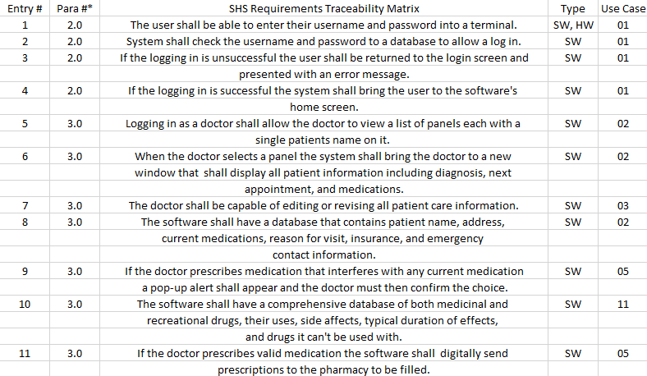
Requirements Traceability Matrix (RTM)

Slide 6
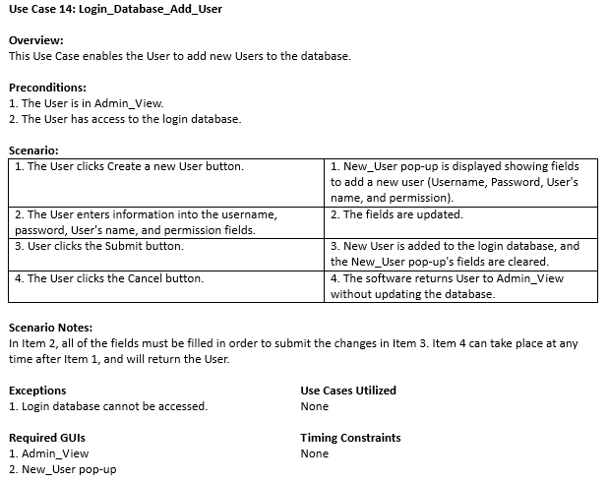
Use Case 14:
This Use Case describes how a User is added to the database by an Administrator.
In the administrator home screen, Admin_View, the User can click the New User button.
This will bring up a pop-up with the username, password, first name, last name, and permission fields.
Once they are filled out, the Administrator can hit submit and a new User will be added to the database.

Slide 7
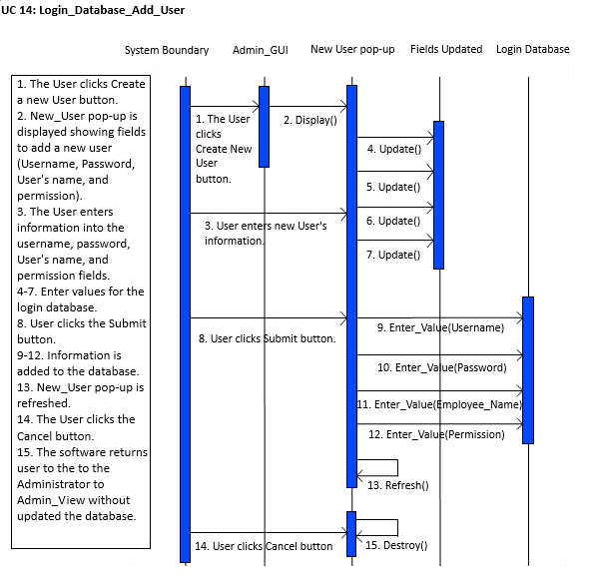
Sequence Diagram 14:

Slide 8
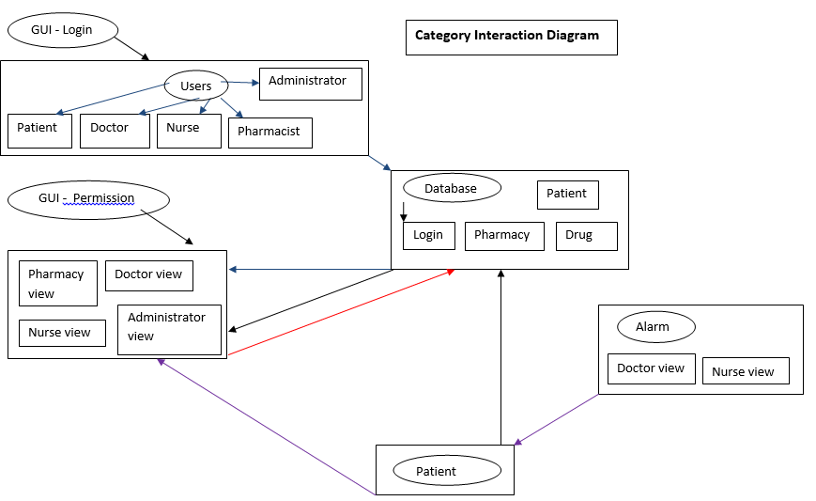
Category Interaction Diagram

Slide 9
Function Point Cost Analysis
Measurement Parameters Average Complexity
User Inputs: 24 x 4 = 96
User Outputs: 16 x 5 = 80
User Inquiries: 22 x 4 = 88
Number of Files: 4 x 10 = 40
External Interfaces: 2 x 7 = 14
Total -------------------------------------------------------------→ 318
Complexity Adjustment Factor: 53.17 FP = 274 x (.65 + .01 x 53.17)
Total FP = 323.32
$8000/7 = $1142.86 per FP ($8000 in labor costs per month, if 7 FP per month)
$1142.86 x 323.32 = $369,508.57

Slide 10
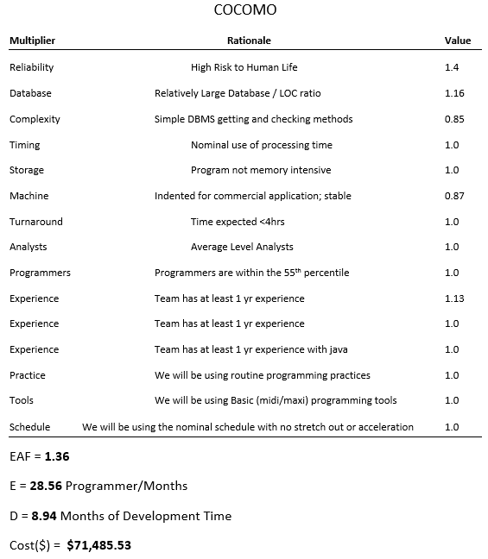
COCOMO
Put comparisons and conclusions
in cheat sheet, not on slide

Slide 11
Dictionary
Some of the jargon used:
Condition - current health situation of a patient – Stable or Critical.
Diagnosis - identification status of an ailment from its symptoms (Diagnosis_View).
Drug - a chemical substance used in the treatment, cure, prevention, or diagnosis of disease or used to otherwise enhance physical or mental well-being; also, any habit forming medicinal or illicit substance, IE narcotics, recreational drugs, caffeine, etc.
Prescription - A written order, by a physician, for the preparation and administration of a medicine or other treatment.
User – Doctors, Nurses, Administrators, and Pharmacists; alternatively referred to as an end-user, a user is any individual who is not involved with supporting or developing a computer or service. The user is any individual who has access granted by an administrator to access the medical system. For example in this case the doctors and nurses are users.

Slide 12
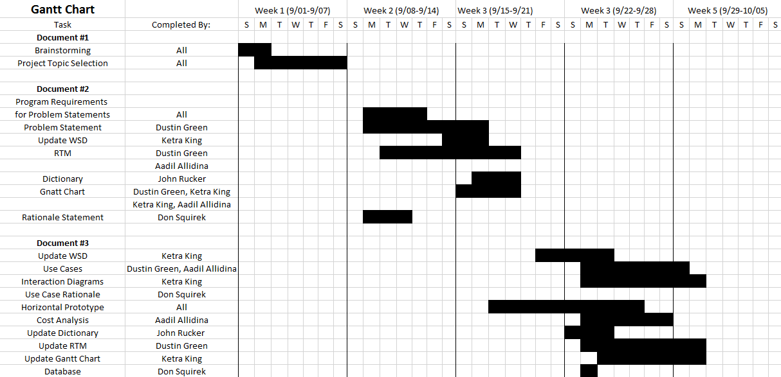
Gantt Chart

Slide 13
Project Legacy
The Good
Project has almost all of the functionality we originally wanted in the text based format, and the GUI looks exactly as shown in the horizontal prototype.
The Bad
Communication problems plagued the development phase to the point where we essentially had two groups, each designing a different piece of software to do the same thing.
For Future Releases
GUI will be integrated with the text-based version of the software to provide a user-friendly program.
Staff will have their schedules encased in each instance of the User object and they will be viewable by other Users.
Software will be capable of reading information from hospital equipment to allow nurses and doctors to view a patient’s pulse, breathing rate, and other vital medical information from their terminal.

